Slide 1
Reinforcement Learning
IE562 Computational Foundations of Smart Systems
Jushkhun
Sep, 2018

Slide 2
Part A

Slide 3
Outline
Reinforcement Learning (RL)
What is RL
Markov Processes and Markov Decision Processes
Value Functions
Bellman Expectation Equation
Optimal Value Function
Solving the Bellman Optimality Equation
Evaluating a Random Policy in the Small Gridworld
Extensions to MDPs

Slide 4
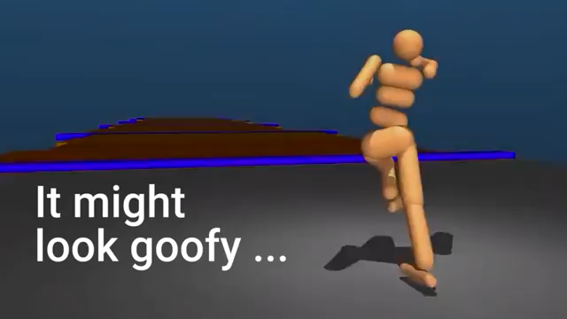
Reinforcement Learning (RL)

Slide 5
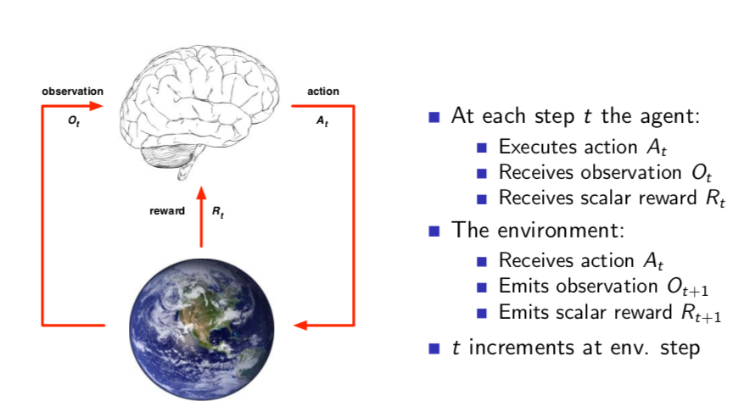
What is RL: Agent and Environment
Goal: find a policy that enables the agent to get the maximum cumulative rewards

Slide 6
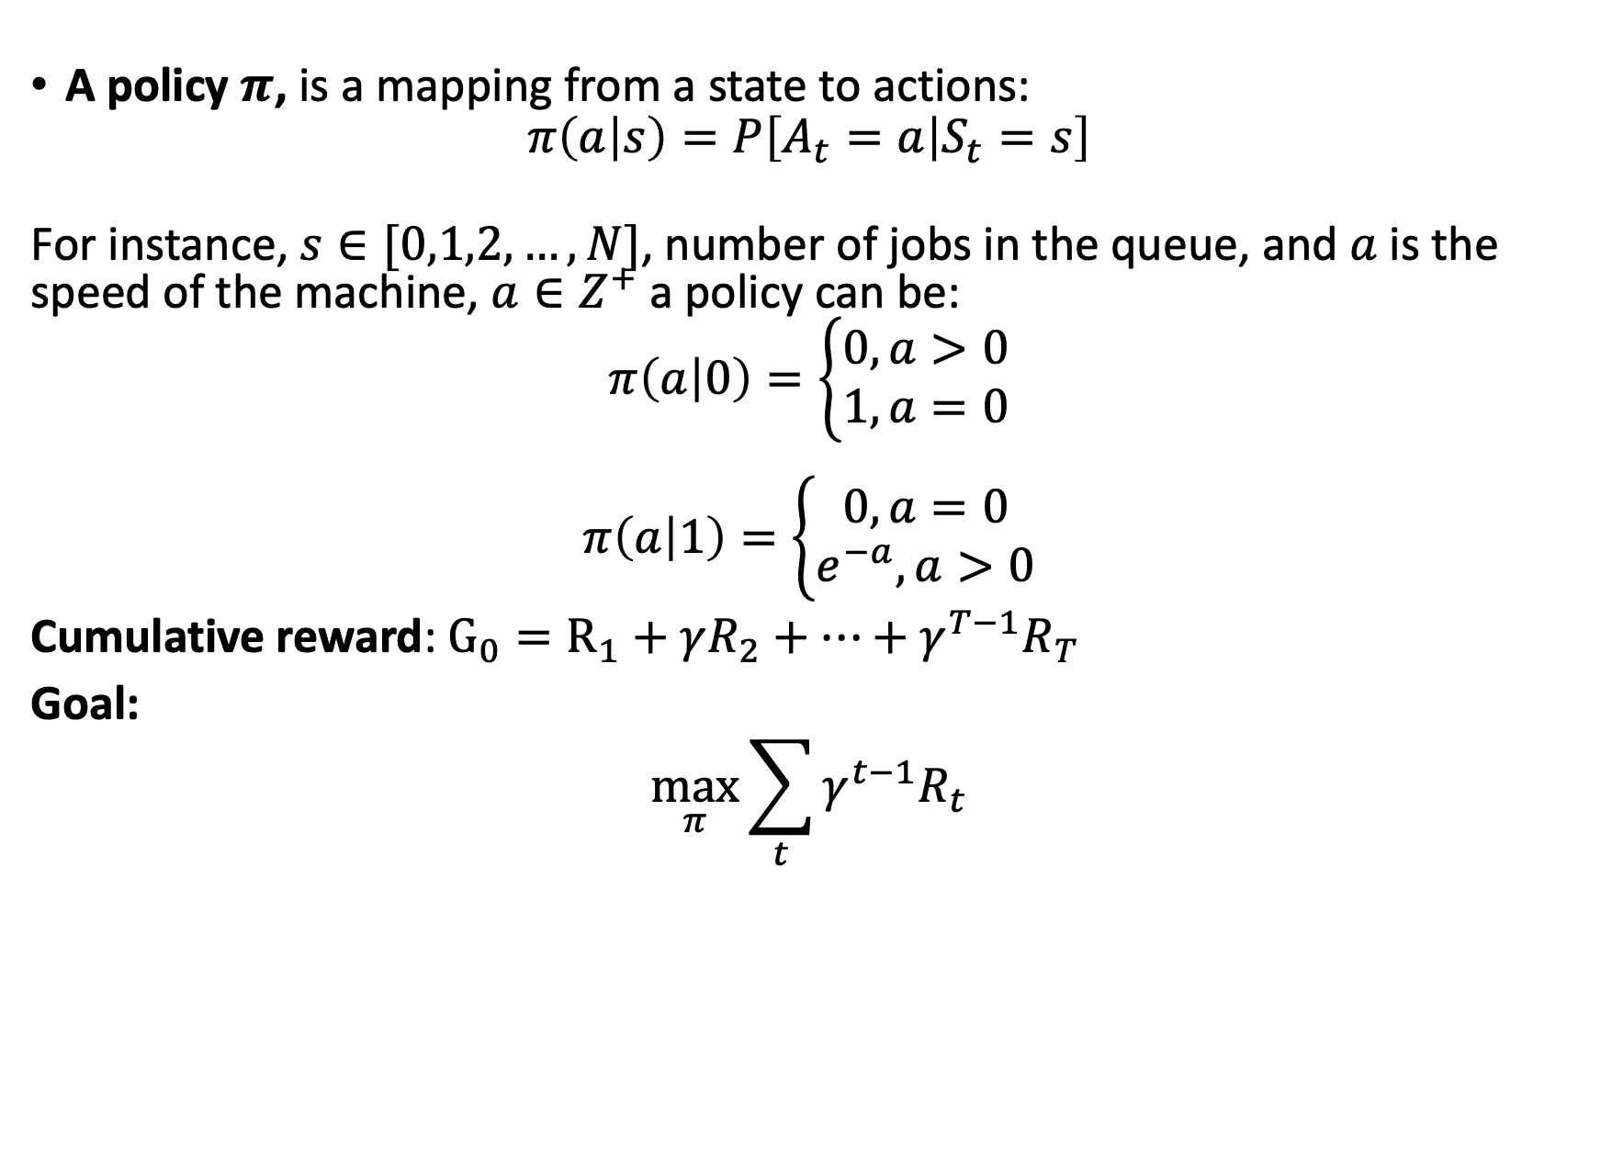
What is RL: Policy and Cumulative Reward
A policy $π$, is a mapping from a state to actions:
$$π\left(a | s\right)=P\left[A_{t}=a | S_{t}=s\right]$$
For instance, $s∈[0,1,2,…,N]$, number of jobs in the queue, and $a$is the speed of the machine, $a∈Z^{+}$a policy can be:
$$π\left(a | 0\right)=\left\{\begin{aligned}0, a>0 \\ 1, a=0\end{aligned}\right.$$
$$π\left(a | 1\right)=\left\{\begin{aligned}0, a=0 \\ e^{−a},a>0\end{aligned}\right.$$
Cumulative reward: $G_{0}=R_{1}+γR_{2}+…+γ^{T−1}R_{T}$
Goal:
$$\max_{π}{\sum_{t}{{γ^{t−1}R}_{t}}}$$

Slide 7
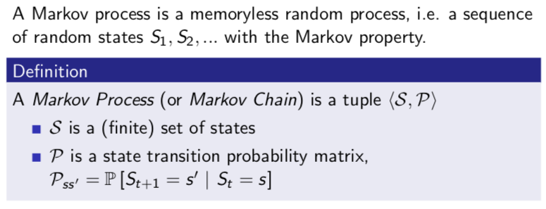
How to solve it? Markov Processes and Markov Decision Processes

Slide 8
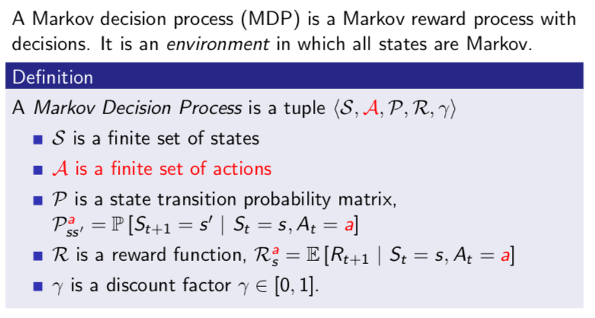
How to solve it? Markov Processes and Markov Decision Processes

Slide 9
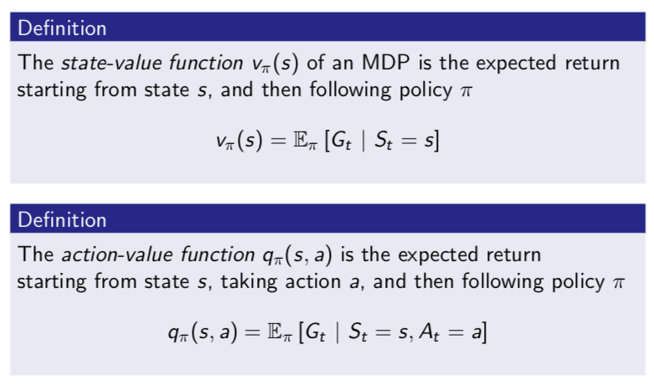
Value Functions

Slide 10
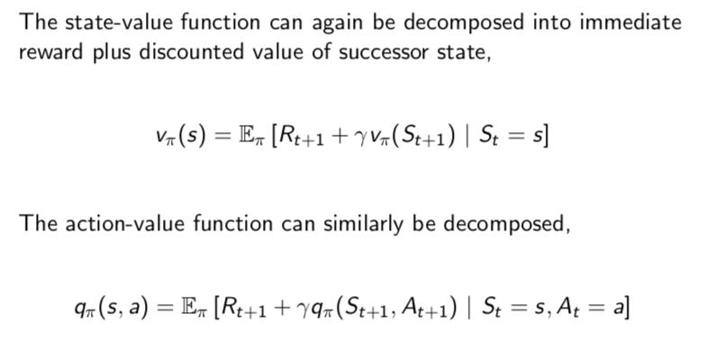
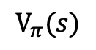
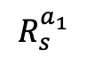
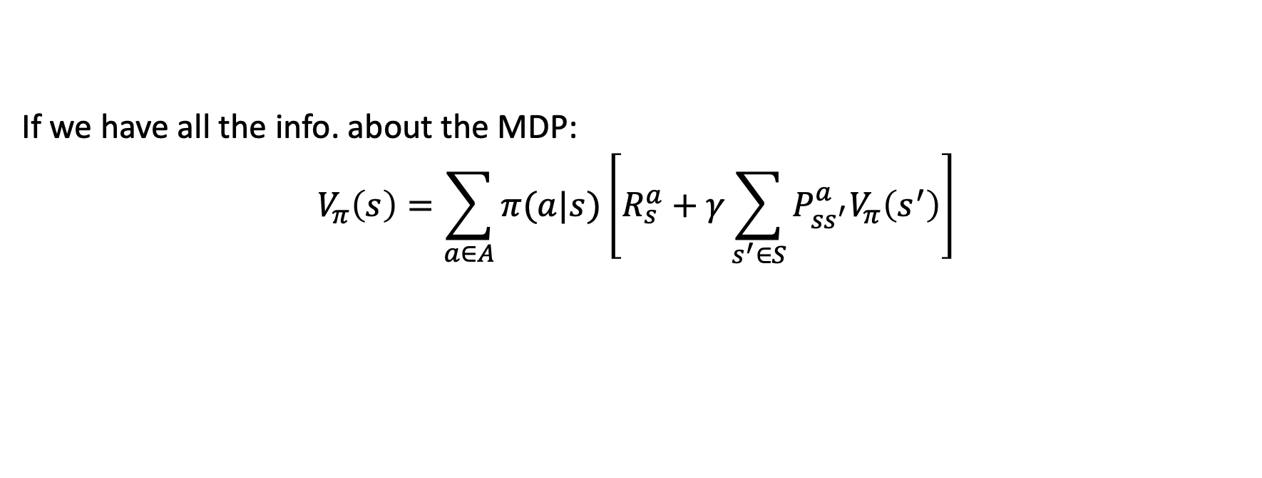
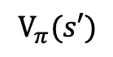
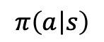
Bellman Expectation Equation
$$V_{π}(s)$$
S
$$π\left(a | s\right)$$
a₁
…
a_{n}
$$R_{s}^{a_{1}}$$
S’
$$V_{π}(s′)$$
If we have all the info. about the MDP:
$$V_{π}\left(s\right)=\sum_{a∈A}{π(a|s)}\left[R_{s}^{a}+γ\sum_{s^{′}∈S}{P_{ss^{′}}^{a}V_{π}\left(s^{′}\right)}\right]$$

Slide 11
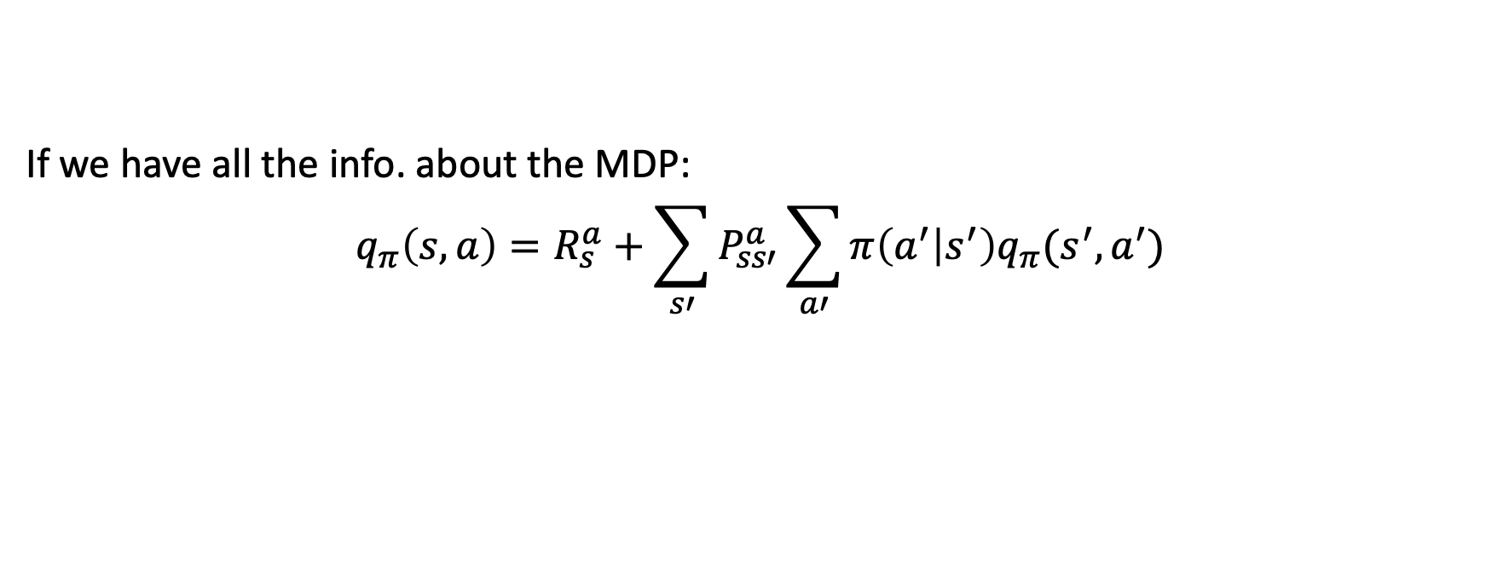
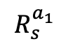
Bellman Expectation Equation (Cont.)
S
a₁
…
a_{n}
$$R_{s}^{a_{1}}$$
S’
a₁
…
a_{n}
If we have all the info. about the MDP:
$$q_{π}\left(s,a\right)=R_{s}^{a}+\sum_{s′}{P_{ss′}^{a}\sum_{a′}{π\left(a^{′} | s^{′}\right)q_{π}(s^{′},a^{′})}}$$

Slide 12
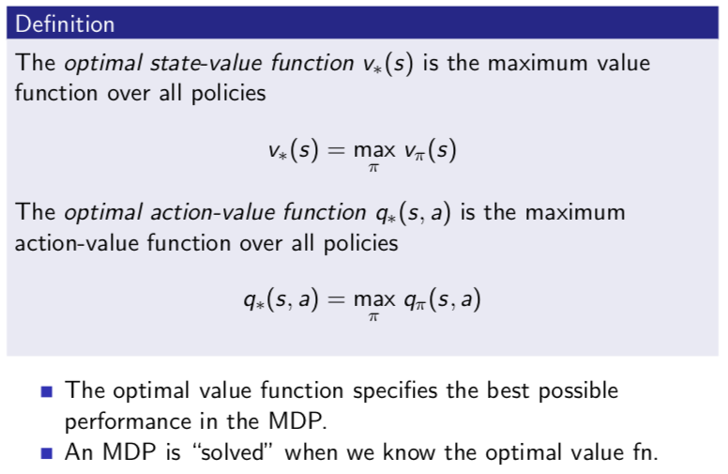
Optimal Value Function

Slide 13
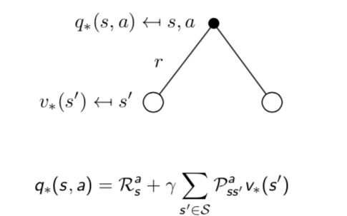
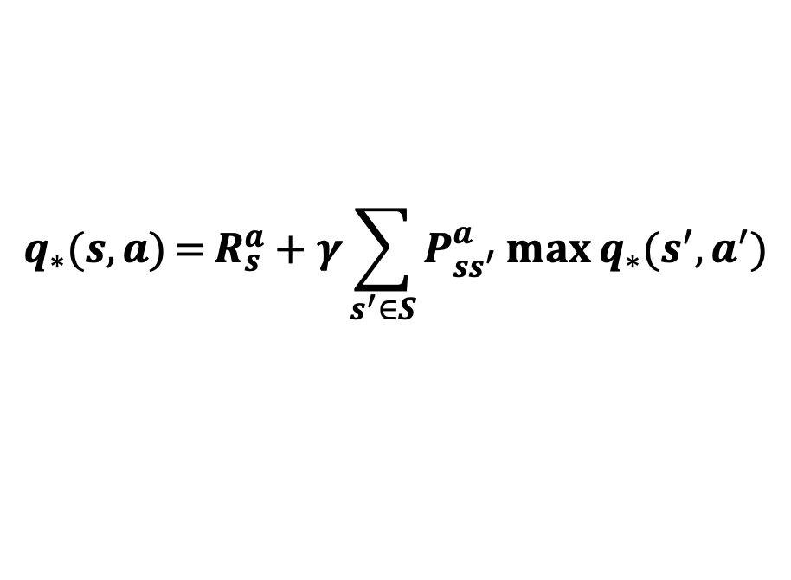
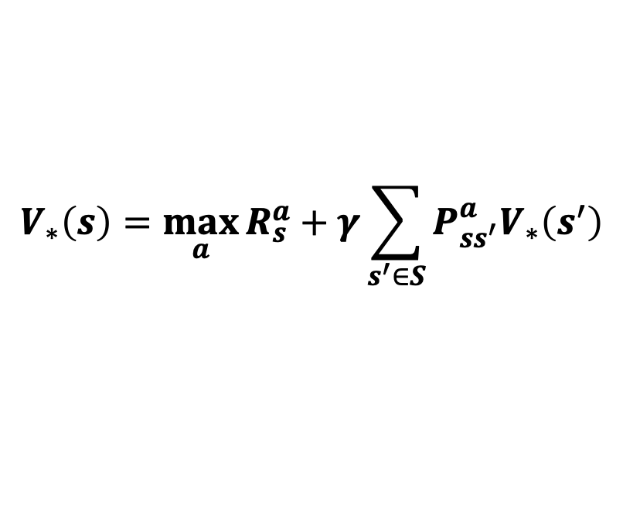
Optimal Value Function (Cont.)
$$V_{∗}\left(s\right)=\max_{a}{R_{s}^{a}+γ\sum_{s^{′}∈S}{P_{ss^{′}}^{a}V_{∗}\left(s^{′}\right)}}$$
$$q_{∗}(s,a)={R_{s}^{a}+γ\sum_{s^{′}∈S}{P_{ss^{′}}^{a}\max{q_{∗}(s^{′},a^{′})}}}$$

Slide 14
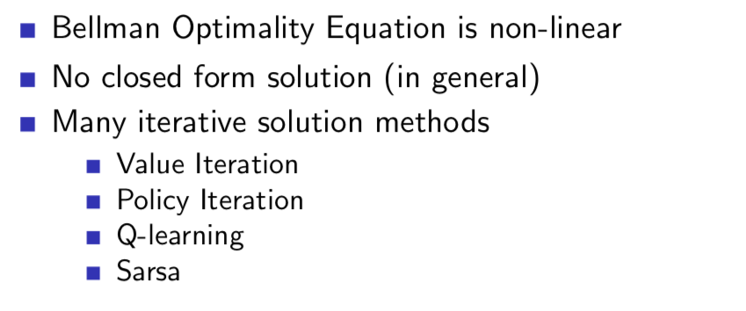
Solving the Bellman Optimality Equation

Slide 15
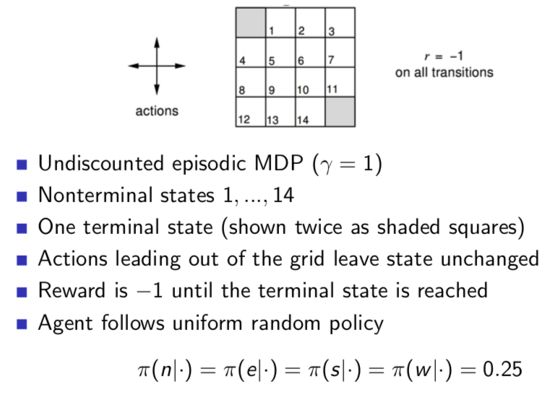
Evaluating a Random Policy in the Small Gridworld
Two

Slide 16
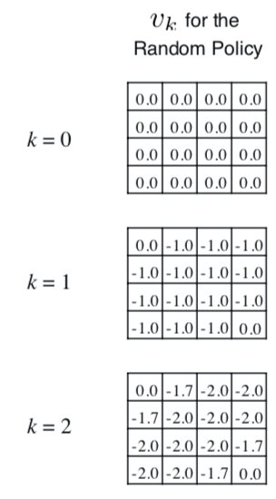
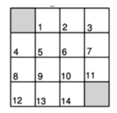
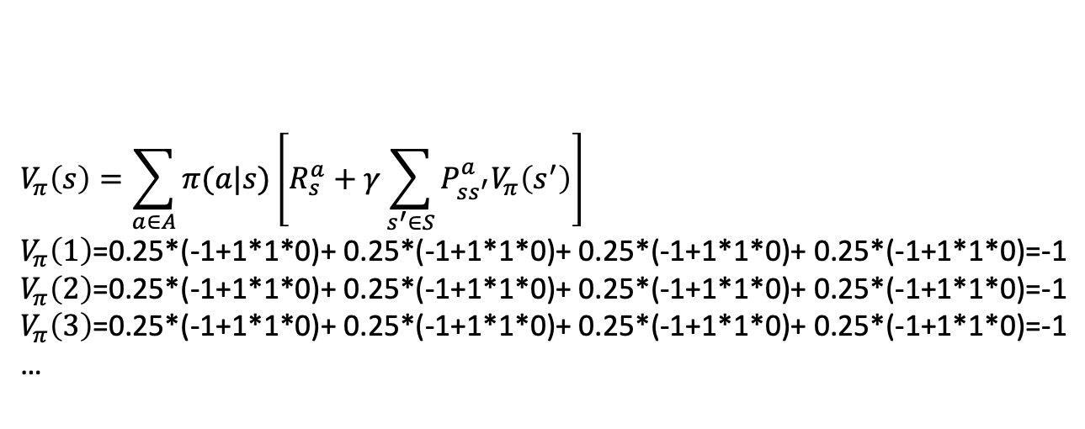
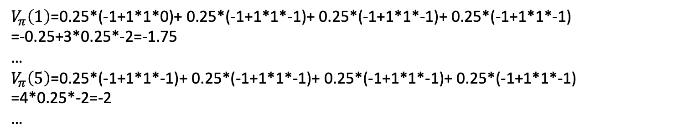
Evaluating a Random Policy in the Small Gridworld Goal: given a policy find V(s) for all s
Initiate v(s) as 0 for all s
$$V_{π}\left(s\right)=\sum_{a∈A}{π(a|s)}\left[R_{s}^{a}+γ\sum_{s^{′}∈S}{P_{ss^{′}}^{a}V_{π}\left(s^{′}\right)}\right]$$
$V_{π}\left(1\right)$=0.25*(-1+1*1*0)+ 0.25*(-1+1*1*0)+ 0.25*(-1+1*1*0)+ 0.25*(-1+1*1*0)=-1
$V_{π}\left(2\right)$=0.25*(-1+1*1*0)+ 0.25*(-1+1*1*0)+ 0.25*(-1+1*1*0)+ 0.25*(-1+1*1*0)=-1
$V_{π}\left(3\right)$=0.25*(-1+1*1*0)+ 0.25*(-1+1*1*0)+ 0.25*(-1+1*1*0)+ 0.25*(-1+1*1*0)=-1
…
$V_{π}\left(1\right)$=0.25*(-1+1*1*0)+ 0.25*(-1+1*1*-1)+ 0.25*(-1+1*1*-1)+ 0.25*(-1+1*1*-1)
=-0.25+3*0.25*-2=-1.75
…
$V_{π}\left(5\right)$=0.25*(-1+1*1*-1)+ 0.25*(-1+1*1*-1)+ 0.25*(-1+1*1*-1)+ 0.25*(-1+1*1*-1)
=4*0.25*-2=-2
…

Slide 17
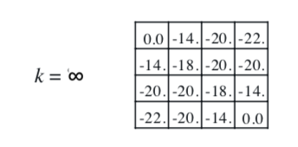
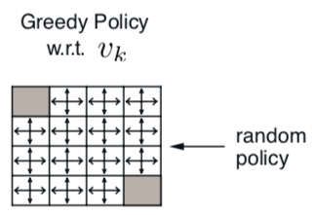
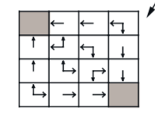
Evaluating a Random Policy in the Small Gridworld Goal: given a policy find V(s) for all s
Optimal Policy

Slide 18
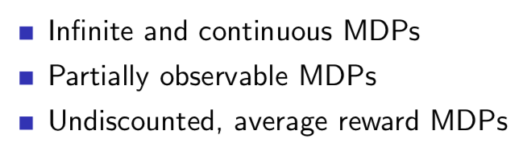
Extensions to MDPs

Slide 19
Reference:
Reinforcement Learning: An Introduction
By Richard S. Sutton and Andrew G. Barto
http://incompleteideas.net/book/bookdraft2017nov5.pdf

Slide 20
Part B

Slide 21
Outline
Recap
Categorizing RL Methods
Model-based:
Policy-based Methods for Planning
Value-based Methods for Planning
Challenges
Model-free:
Policy-based Methods for Learning
Monte-Carlo Methods
Temporal-Difference Methods
Value-based Methods for Learning
SARSA
Q-learning
More

Slide 22
Recap Supervised, Unsupervised Learning and RL
You have a target, a value or a class to predict. A model is trained to minimize a loss function to minimize the cross entropy or mean squared error between predictions and true values
You have unlabelled data, unsupervised machine learning will group the data by minimizing a given loss function (minimize the sum of distances between the central of each cluster and elements inside the cluster)
You want to attain an objective (maximize a reward signal or minimize penalty), reinforcement learning will play this game many times to find the best policy

Slide 23
Recap: RL
Goal: find a policy that enables the agent to get the maximum cumulative rewards

Slide 24
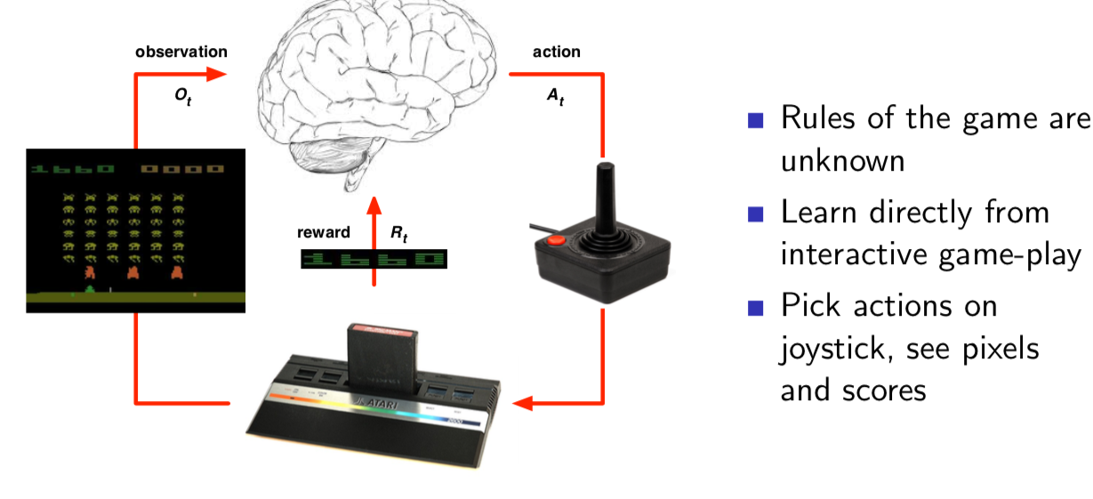
Categorizing RL Methods
Policy-based methods (PBMs)
Value-based methods (VBMs)
Actor Critic
Two types of problems:
The Planning Problem:
A model of the environment is known (Model-based)
Compute values function given a policy
Improve the policy , go back to 1 until the policy is converged
The Learning Problem:
The environment is initially unknown (Model-free)
Interacts with the environment
Improve the policy, go back to 1 until the policy is converged
PBM
PBM
When the MDP is complex, a planning problem can be treated as a learning problem

Slide 25

Atari breakout: An Example of Learning (model-free)
Human-level control through deep reinforcement learning

Slide 26
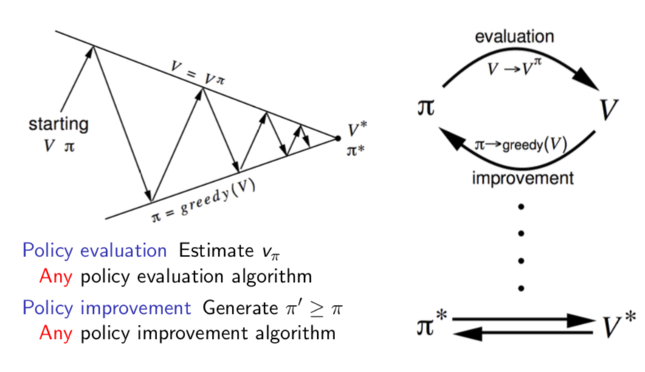
Policy-based Methods for Planning

Slide 27
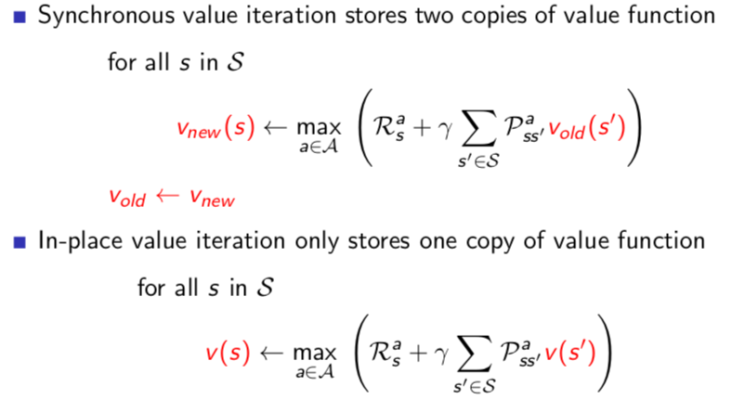
Value-based Methods for Planning
Both methods will converge to v* (check the book)

Slide 28
Value-based Methods for Planning

Slide 29
Model-based: Challenges
For large problems DP suffers Bellman’s curse of dimensionality
Numbers of states n grows exponentially with number of state variables
What we do? Treat it as a learning problem!

Slide 30
Policy-based Methods for Learning
Policy-based Methods
Policy evaluation: evaluating value functions given a policy
Policy improvement: improve the policy by acting greedily in terms of the values
Hard part is the evaluation
Methods:
Monte-Carlo methods
Temporal-Difference methods

Slide 31
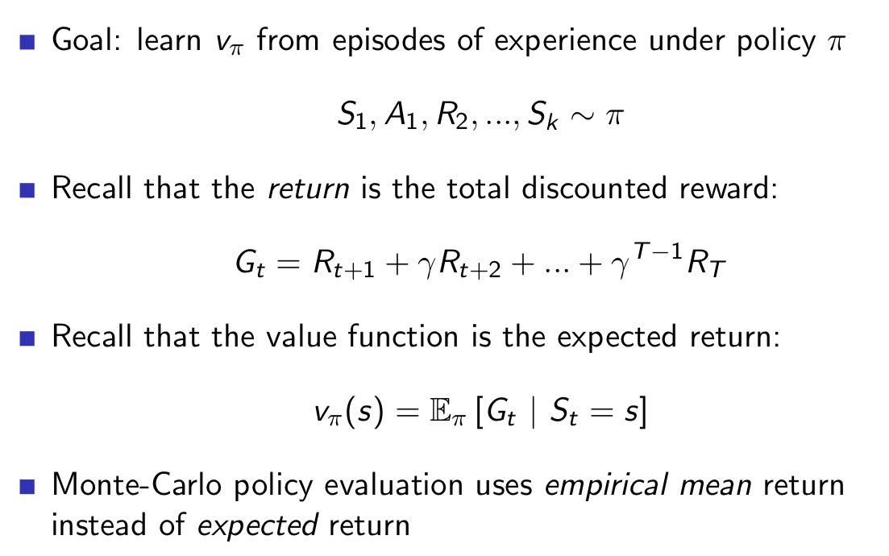
Monte-Carlo Methods

Slide 32
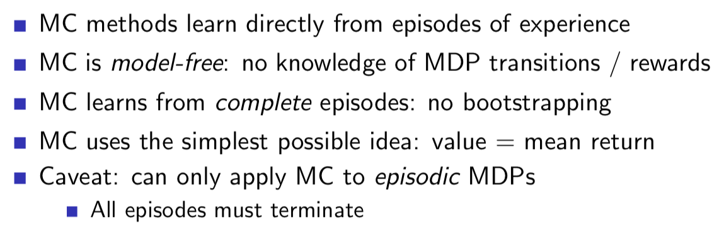
Monte-Carlo Methods

Slide 33
Monte-Carlo Methods (Cont.)
First-Visit Monte-Carlo Policy Evaluation

Slide 34
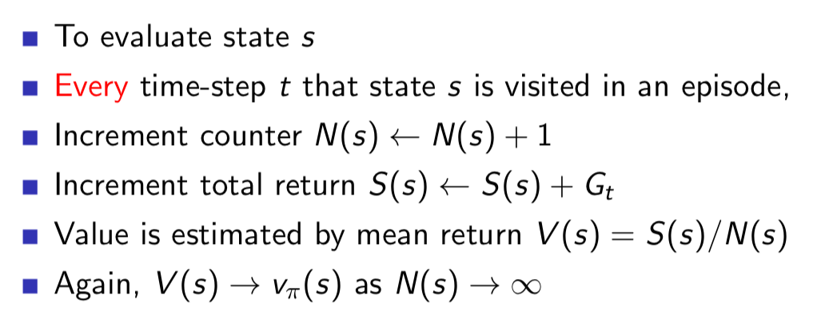
Monte-Carlo Methods (Cont.)
Every-Visit Monte-Carlo Policy Evaluation

Slide 35
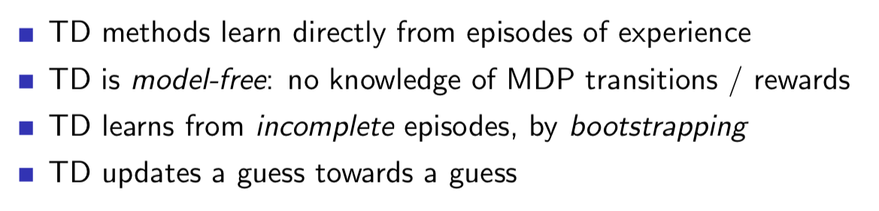
Temporal-Difference Methods

Slide 36
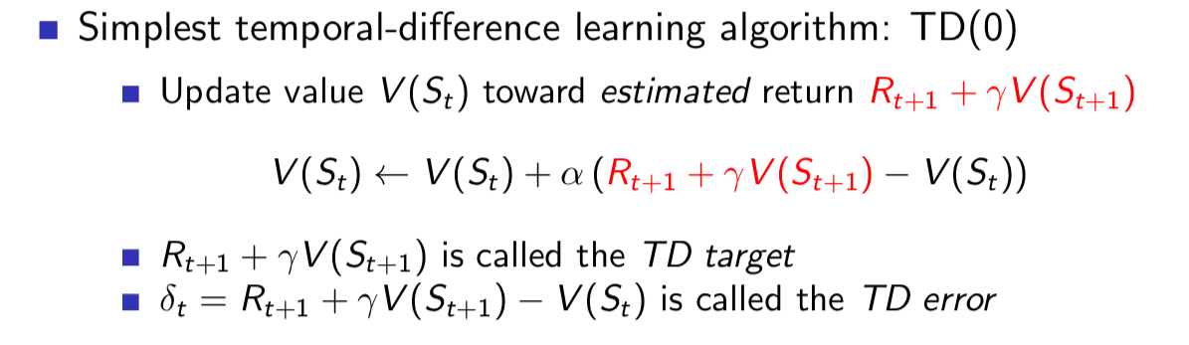
Temporal-Difference Methods (Cont.)

Slide 37
Advantages and Disadvantages of MC and TD

Slide 38
Value-based Methods for Learning
There is no a fixed policy
Instead, the agent will always act greedily in terms of Q(s,a)
Methods:
SARSA
Q-learning

Slide 39
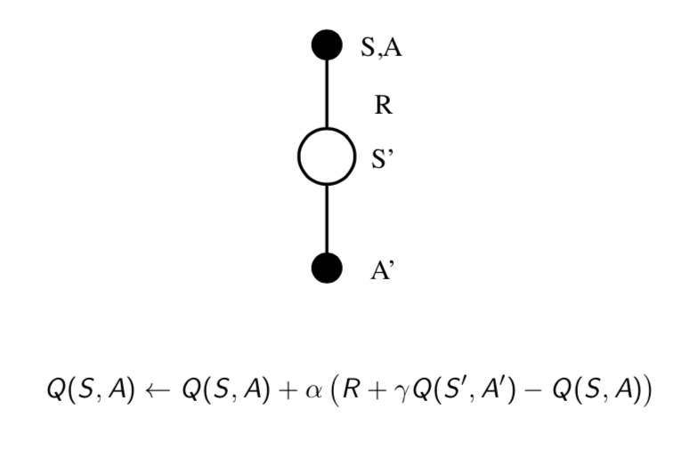
SARSA

Slide 40
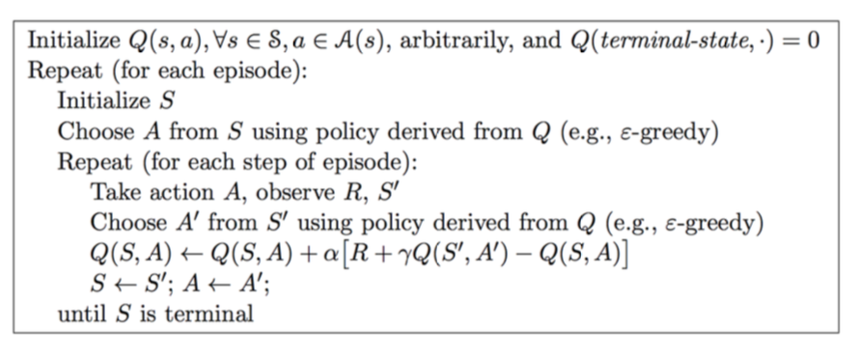
SARSA (Cont.)

Slide 41
Q-Learning

Slide 42
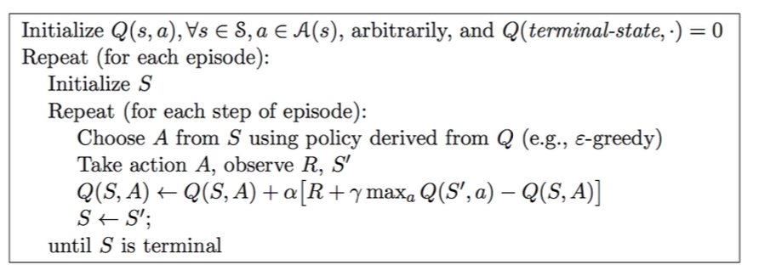
Q-Learning (Cont.)

Slide 43
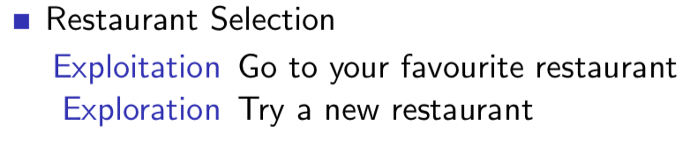
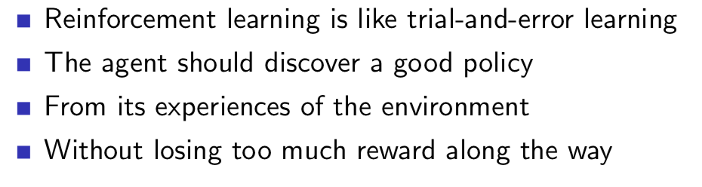
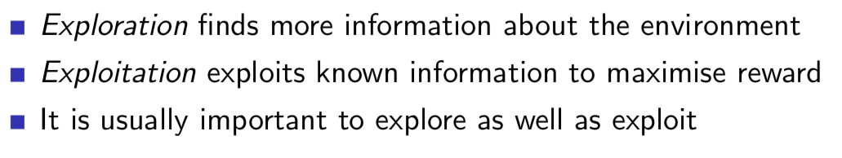
Exploration and Exploitation

Slide 44
More
TD-lambda
N-step SARSA
SARSA-lambda
Deep Q-learning
Eligibility trace
Important sampling
Actor crtic
….

